Slide 1
Erasmus+ KA1 2019-2020 Na cestě za jazykovými dovednostmi

Slide 2
WHAT NUMBER IS IT?
Martina Miškovská Výukový materiál č.3

Slide 3
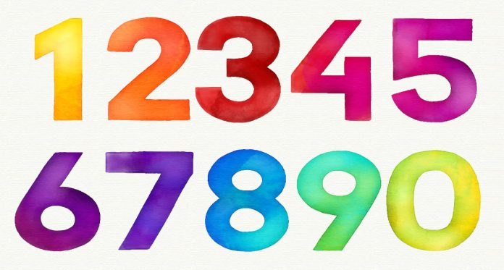
WHAT NUMBER IS IT?
NU

Slide 7
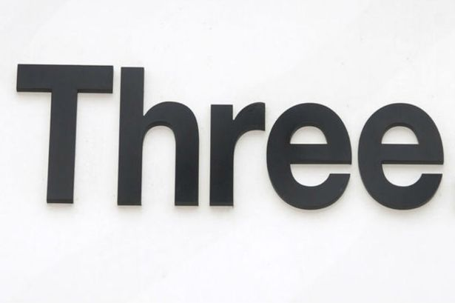

Slide 10
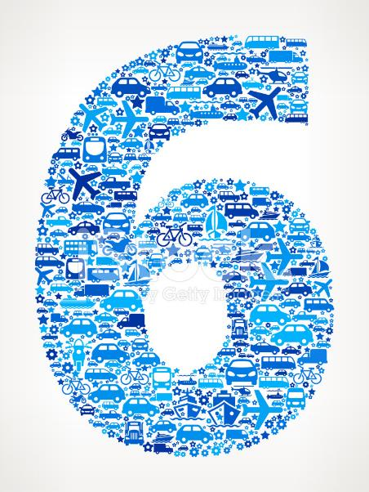

Slide 13
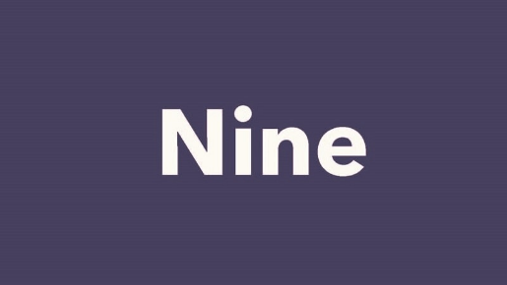

Slide 15
Count with me….

Slide 16
Použité odkazy
Numbers in English - Learn with Games Flashcards Pictures Quizzes (english-learn-online.com)
Hand gesture number zero Royalty Free Vector Image (vectorstock.com)
Zálohování Google One je dostupné pro všechny | Dotekomanie.cz
ONE – Wikipedia
(446) Pinterest
Two – Dating & Relationships (byu.edu)
The Three Things You Should Have Read This Week (08/31/18) — Pastor Matt's Blog
Three Data Reward SIM: How To Get 200mb of Data Free Every Month - TigerMobiles.com
PikPok | Four Letters — PikPok
Five signs your financial manager is not working in your best interest | Financial Post
Five Confetti Type Word. 3D Rendering Stock Photo, Picture And Royalty Free Image. Image 92799544. (123rf.com)
wT_D7X-P.jpg (512×512) (twimg.com)
Number Six on Transportation Royalty Free Vector Art Pattern Stock Vector - FreeImages.com
Lucky+Number+7.png (1200×1600) (squarespace-cdn.com)
92799260-seven-confetti-type-word-3d-rendering.jpg (1300×560) (123rf.com)
1000 × 1000 (cloudinary.com)
1200 × 630 (gstatic.com)
460 × 217 (wikimedia.org)
800 × 450 (sheridancollege.ca)
600 × 600 (kidsmathgamesonline.com)
1024 × 577 (quizlet.com)

